Slide 1

CE303
Advanced Programming
Unit 1. Oct 18th, 2022.
Notes:
Is this the real life

Slide 2
Welcome
To CE303: Advanced Programming
Dr Tasos Papastylianou
tasos.papastylianou@essex.ac.uk
Notes:
Welcome. I hope you’re all very excited to be here.
Introduce myself. Pianist -> Doctor in NHS -> Computer Science / Machine Learning.
First time teaching this particular module (as previous lecturer has gone on paternity leave. Yay babies!)
It’s been a while since I used Java myself, but Java is an awesome language, exciting to teach it to my colleagues in training such as yourself.
My goal is for us to go on a journey together to explore some of the more advanced features of the language.
- So what does this module entail? Here’s the trailer:

Slide 3
CE303 Overview
Functional Interfaces
Unit Tests
Threads and Concurrency
I/O and Serialisation
Sockets
Web requests
Generics
Collections
Streams
Optional
Program Optimisation & Design patterns
Functional Programming (Haskell)
Notes:
Play Guile’s theme on the mobile for added effect.
This might be a good time to ask everyone to turn their phones off :p

Slide 4
Module background
Expected to have done some Java programming previously and be comfortable with the basics
Occasionally compare how other languages do things, but main focus is Java
Not an introductory module!
(builds on last 2 years’ experience!)
If you need a refresher beyond today – moodle reading list.
Learn how to make Java do some cool stuff!
(also Haskell towards the end – not assessed)
Notes:
Note on prerequisites on module description.
Note, no GUI stuff in this module.

Slide 5
Module organisation
Weekly lectures (2h) and labs (2h)
Labs: CSEE Labs 1, 3, 4, 6 (First Lab: all gather in Lab1 first!)
Total mark for module consists of:
2 MCQ Progress Tests (Weeks 7 and 11) (20% each)
One programming assessment in Java (60%)
No Summer exam.
Moodle
Unit content (regrettably) still being updated. Will try to put materials as much in advance as possible.
Many facilities (Forums, MoodleOverflow, Chat, Feedback)
Anki! \o/
Notes:
Encourage to have a look at moodle.

Slide 6
Module organisation (continued)
Labs
Dedicated time to work on code and ask questions.
Some questions in progress tests will be from material covered in the labs
Indicative ‘solutions’ for labs also provided in moodle
Attendance at labs is compulsory! (and acted on in LEAP)
Listen again
Laptop and Visualiser may not show up in listen again.
Will provide code snippets etc used in lectures on moodle
If time allows, I will edit videos / captions.
Notes:
Make the most of labs
Point out GLAs vs Solution-driven approach in labs.
Attendance (i.e. “Tapping In”) at Labs is compulsory, and BigBrother, uh, LEAP sees all.
But! I see you as professional colleagues. Be professional.
Re, captions – any volunteers?

Slide 7
Previously in CE303…
Course follows same structure as last year.
Both choice of material and assessments
Lectures and labs should be enough to complete exercises/assignments.
No specific textbook, but list of useful (optional) resources on moodle for your enjoyment. Self-directed learning encouraged!
CE303 lectures from previous years available on panopto.essex.ac.uk. You are very welcome to view these too if you’d like.
Past student feedback in recent years has been mostly positive
“Negative feedback/comments in the past were highly correlated with students who attempted this course without a good background in java programming skills, who then struggled to keep up with the nature of the material”
Notes:
(obviously previous years were taught by another person)

Slide 8
A bit about yourself
Background Java Level?
Familiarity with Linux?
Coding preference (Terminal vs IDE)?
Go to: https://pollev.com/ce303 to vote!
Notes:
Poll questions:
Background Java Level
Linux
Intellij vs Terminal (no other IDEs on this course)

Slide 9
Part 1
Java basics revisited
Notes:
In the first part of this lecture, we’re going to do a quick recap of basic concepts in java, before we go on to talk about functional interfaces and unit tests.
This is useful to put things into perspective; however, please note, in theory this part of the lecture should be concepts you are already familiar with.

Slide 10
Java is an object-oriented language
Unlike other languages, there are no ‘free’ functions in java.
Everything works via Classes and Objects which expose methods.
Even the ‘main’ entry point of programs meant to be executed by a shell.
Classes can be organised into packages
These act as namespaces for classes.
Java Runtime Environment generally consists of
JVM
Utilities (e.g. java executable) (vs javac/javap in the JDK)
Standard classes (including all implicitly imported ones from java.lang package)
Notes:
If lecture flowing well, consider showing snippets of c+nm vs javap (with packages)
(here or in the next slide)

Slide 11
The Java Virtual Machine
The ClassLoader. What is in a compiled .class file?
Metadata regarding package, number and names of methods, implemented interfaces, referenced classes, etc
Method definitions (in bytecode) and class-specific constants
See https://docs.oracle.com/javase/specs/jvms/se17/html/jvms-4.html if interested!
The JVM Memory model
Class (Method) Area
Heap
Stack
(Program Counter Register)
(Native method stacks)
Notes:
Javap example?
- No need to know this in detail, but it’s important to understand a bit, because the memory layout of the JVM has implications for thinking in terms of
- What is available for assignment/access as an object vs ‘hidden resources’
What an assignment statement means in terms of "Allocate Memory according to this constructor“
How this affects method overriding, or hiding/shadowing of elements
E.g. instantiating an object via an interface may cause it to not have access to a local variable

Slide 12
The Four Pillars of Object-Oriented Programming
Inheritance
Encapsulation
Abstraction
Polymorphism
Notes:
We will talk about each of these aspects, and how they are implemented specifically in java.
May I ask that if you have questions, make a note of the slide and ask at the end of a section

Slide 13
Inheritance
Notes:
May I ask that if you have questions, make a note of the slide and ask at the end of a section

Slide 14
Inheritance
Typically described as an ‘is a’ relationship
E.g. a Dog “is an” Animal
Can lead to confusion, as other things can also be said to have an ‘is a’ relationship (e.g. Interfaces)
Alternatively described as a “Parent / Child” relationship
Useful when visualising hierarchy, but also misleading
Better: Ability for one class to extend the functionality of another
e.g. from simpler/general to ‘more elaborate’/specialised.
But. Keep in mind SOLID principles of good Object-Oriented Design.
This relationship is typically represented via UML diagrams
Notes:
S in SOLID stands for Single Responsibility Principle. A class should only have one reason to change.
So “elaborate” does not meen overstuffed with irrelevant functionality so that it does a large number of unrelated things. We extend classes to make them specialised, but still with a single specialised purpose in mind
Draw example of UML with A: int a b, getSum and B: a,b,c getSum extends A

Slide 15
Inheritance - basics
A class can extend another class
We say that the subclass “inherits” from the super (“parent”) class
A subclass inherits attributes and methods from its parent
A subclass might end up ‘hiding’ parent attributes
Typically should be avoided, as it leeds to confusing situations.
A subclass can override parent methods
In Java, a class extends at most one other class.
i.e. single-rooted hierarchy, no multiple inheritance.
Every class inherits from java.lang.Object

Slide 16
Inheritance – Overriding Methods
To override means to replace the definition of a superclass method with another. Not to be confused with “overloading”
The overriding method should have the same parameter signature (i.e. number and type of input parameters), and return either the same type, or a covariant return type to the original.
Any method of the superclass can be overridden, unless declared final
The overriding method has to be “at least as visible” as the original method.
E.g. you can not override a public method to make it protected, default, or private.

Slide 17
// in file Employee.java
public class Employee {
protected String name;
protected double salary;
public Employee( String aName, double aSalary ) { name = aName; salary = aSalary; }
public void setSalary( double aSalary ) { salary = aSalary; }
public String getName () { return name; }
public double getSalary() { return salary; }
}
// in file Manager.java
public class Manager extends Employee {
public double bonus;
public Manager( String aName, double aSalary, double aBonus) { super( aName, aSalary ); bonus = aBonus; }
void setBonus( double aBonus ) { bonus = aBonus; }
public double getSalary() { return salary + bonus; }
}
Notes:
Canonical example.
Note that super needs to be the first statement in the constructor of the subclass

Slide 18
Covariant return type example
An overriding method in a subclass may return a more specialised “variant” of the method being overridden.
// in file Employee.java
public class Employee {
…
public Employee copy(){
return new Employee(name, salary);
}
}
// in file Manager.java
public class Manager extends Employee {
…
public Manager copy(){
return new Manager(name, salary, bonus);
}
}
Notes:
Before Java 5, the compiler would complain that the overriding method did not have the same return signature.
From Java 5 onwards the return type can be covariant, i.e. a type which is more specialised (i.e. extends) the original.
This achieves the L in SOLID (Liskov Substitution Principle).
We’ll see this a bit later as well when we discuss polymorphism

Slide 19
Inheritance – Invoking superclass methods and constructors
A class can not access private features of its super class
Superclass methods:
If a subclass overrides a parent method, use the super keyword (as an object) to call the parent method inside the subclass
There is no super.super (it would bypass the parent class)

Slide 20
Inheritance – Invoking superclass methods and constructors
Superclass constructors:
Use the super() call with appropriate arguments as the first statement in a constructor, to initialize the inherited superclass.
If no explicit call to super(), assume implicit call to a parent constructor that takes no parameters (this must exist in the superclass!).
Superclass construction happens before initialization and execution of the rest of the subclass constructor body
Important, e.g. in the case of instance initializers (standalone blocks that are run before the constructor statements, but after superclass initialization)

Slide 21
toString() method
Returns a string representation
Method is used silently in string concatenation. E.g.
aString + anObject
means
aString + anObject.toString()
Object.toString() consists of ClassName + the object’s HashCode
System.out.print( obj ) calls obj.toString() implicitly.
Notes:
Useful for debugging.

Slide 22
public class Employee {
…
public String toString() {
return getClass().getName() + "[name=" + name + ", salary=" + salary + "]";
}
}
public class Manager extends Employee {
…
public String toString() { return super.toString() + "[bonus=" + bonus + "]"; }
}
Notes:
Example overriding toString() using super

Slide 23
Encapsulation
Notes:
Any questions on inheritance?

Slide 24
Access modifiers
Java provides 4 access modifiers. In order of visibility, from ‘least’ to ‘most’, they are: private, (default), protected, and public
Private fields and methods cannot be accessed by any class or subclass
Default fields and methods are “package private”: they are visible from other classes or subclasses within the package, but not outside of it.
Protected: Visible by all classes or subclasses within the same package, or subclasses (but not other classes) from any external package.
Public: Accessible from any class or package
Classes and interfaces at the ‘top level’ of a file can only be public or (default).
Notes:
Comment on how Java confusingly calls protected etc “weaker”, because they are weaker in terms of ‘access’ (public has ‘stronger’ access because it’s open to everything).

Slide 25
Why are access modifiers useful?
Why is it important to have such access levels? Why not make everything public?
The reason, is “other people”, especially when working in large projects/teams.
“Other people” could also be you in two months time, after you’ve forgotten what your code was supposed to do, and then you start breaking things!
Encapsulation helps ‘protect’ classes from being used inappropriately and then ‘breaking’ because their internals were modified! By restricting access to precious internals and only providing a public interface for their use, you have a better reassurance that your class will work as intended!

Slide 26
Non-access modifiers
There are other modifiers, which do not relate to access in terms of ‘visibility’:
Final:
In front of a class: the class cannot be extended / subclassed further.
In front of a field: Can only be explicitly initialized once, and cannot be reassigned to further after that.
In front of a method: The method is not allowed to be overridden in a subclass.
Static (next slide)
Abstract (next section)
Synchronized / transient / volatile (next few lectures)
Conventional order: [access modifier] [non-access modifier] [type] [name]
Notes:
Note: Attribute is another word for field; however, when people use this word they typically mean something that can be accessed in some way (so you wouldn’t say private attribute)

Slide 27
Static
The static keyword means that the member is shared by all instances of the class. E.g. field x can be accessed from any instance of A or via the classname A itself (i.e. as A.x):
One cannot access this or any non-static members from a static method.
If you find yourself tempted to change members to static to avoid compilation errors, you should probably reconsider your design instead!
public class A {
private static int x = 0;
…
}
Notes:
Specifically, static means the variable “stays” (hence “static”) with the class in memory terms. Objects only hold a reference to this.

Slide 28
Hiding vs Shadowing
One aspect of encapsulation is ‘hiding’ or ‘shadowing’ of methods or variables, resulting in reduced visibility of the variables or methods that get affected.
The two are similar but different concepts.
Hiding typically refers to obscuring access to variables or static methods from a subclass.
Shadowing typically refers to obscuring access of ‘outer’ scopes from ‘inner’ scopes.

Slide 29
Hiding
An attribute in a subclass hides an attribute with the same name in a parent class (even if attribute has different type)
The parent class attribute can still be accessed via the super keyword
A static method in a subclass “hides” a static method with the same name in a parent class.
Can still call the “hidden” method by prefixing the method name with the class name.
Notes:
Hiding of attributes is in general not recommended; be careful not to accidentally hide attributes.

Slide 30
public class Main
{
public static void main( String [] args )
{
One.say();
Two.say();
Two.sayFromOne();
}
}
class One {
public static void say() { System.out.println( "Helloooooooo!" ); }
}
class Two extends One {
public static void say() { System.out.println( "Also hellooo!" ); }
public static void sayFromOne() { One.say(); }
}
Output:
Helloooooooo!
Also hellooo!
Helloooooooo!

Slide 31
Shadowing
If a variable in a particular (inner) scope has the same name as another declaration in an ‘enclosing’ (outer) scope, then the declaration shadows the declaration of the enclosing scope.
You cannot refer to a shadowed declaration by its name alone, since this would be ambiguous; therefore to access the shadowed field, this needs to be qualified by the enclosing class's name as well as the this keyword.

Slide 32
public class ShadowTest {
public int x = 0;
class FirstLevel {
public int x = 1;
void methodInFirstLevel(int x) {
System.out.println("x = " + x);
System.out.println("this.x = " + this.x);
System.out.println( "ShadowTest.this.x = " + ShadowTest.this.x);
}
}
public static void main(String... args) {
ShadowTest st = new ShadowTest();
ShadowTest.FirstLevel fl = st.new FirstLevel();
fl.methodInFirstLevel(23);
}
}
Output:
x = 23
this.x = 1
ShadowTest.this.x = 0

Slide 33
Abstraction
Notes:
Any questions on encapsulation?

Slide 34
Abstraction in Java
Two main types:
Interfaces
Abstract Classes

Slide 35
Interfaces
An interface is a special reference type, similar to a class
(but it is not a class, and cannot be instantiated itself!)
An interface can be implemented by a class (often called “the implementor”)
An interface dictates what functionality (i.e. public methods) must be present in a class, in order to be considered an implementation of that interface.
Occasionally referred to as a ‘contract’ between the class and the interface
A class can implement more than one interface(s)
The intent is to “decouple the ‘interface’ (i.e. functionality) from the ‘implementation’ specifics”
A user does not need to know how the steering wheel connects to the engine. They just need to know there’s a steering wheel! If you changed the engine type, the user shouldn’t have to change how they use the wheel!

Slide 36
Interfaces
Interfaces can extend other interfaces.
Multiple inheritance among interfaces is allowed (but, see “I” in “SOLID”)
All methods defined in an interface are implicitly public and abstract
i.e. they lack an implementation, and need to be publicly overridden – this is the whole point of an interface.
All variables are implicitly static and final (i.e. constants).
Special methods in interfaces
Default methods (new from Java 8 onwards)
Static methods (new from Java 8 onwards)
Notes:
Variables: (note: hidden if you "overwrite" from class, inaccessible if not defined in interface and variable was initialised via interface)
Use this point to revisit Implications for thinking in terms of "Allocate Memory according to this constructor" (e.g. for method overriding, or elements present in an interface vs implementor)
(if there is time)

Slide 37
import java.util.List; import java.util.ArrayList; import java.util.Collection;
public class Main {
public static void main( String [] args ) {
List<Integer> myNumbers = new ArrayList<>();
for( int i = 0; i < 5; i++ ) { myNumbers.add( i ); }
int mySum = Main.sum( myNumbers );
System.out.println( "My sum is: " + mySum );
}
public static int sum( Collection<Integer> myList ) {
int result = 0;
for (int x : myList) { result += x; }
return result;
}
}
Notes:
Let’s see an example of using interfaces

Slide 38
“for each” loops
For (T x : myList)
is shorthand for
Iterator<T> it = myList.iterator();
While ( it.hasNext() ) { T x = it.next(); }
Leads to shorter, more readable code.
Can be used with arrays, or any class implementing the Iterable interface

Slide 39
Default methods in Interfaces
Introduced in Java 8.
A default method is not abstract – has an implementation, right in the interface
Default methods can, but do not have to be implemented by implementing classes.
Useful when ‘evolving’ an interface (indeed Java itself has used this)
interface Comparator<T> {
int compare(T o1, T o2);
...
// Returns a comparator that imposes the reverse ordering of this comparator.
default Comparator<T> reversed() { … }
// Returns a lexicographic-order comparator with another comparator.
default Comparator<T> thenComparing( Comparator<? super T> other ) { … }
...
}

Slide 40
Default methods and the
“multiple inheritance problem”
If a class inherits several implementations of a method with the same name (either from default implementations only, or also with direct inheritance), we could have multiple inheritance conflicts.
Java resolves these as follows:
Inheritance from a class has priority over inheritance from an interface
Derived interfaces or sub-interfaces take higher precedence than interfaces higher up in the inheritance hierarchy
If you code a new class that implements different interfaces which share the same method, and it is declared as default in at least one of them, then the method has to be explicitly overridden in the new class.

Slide 41
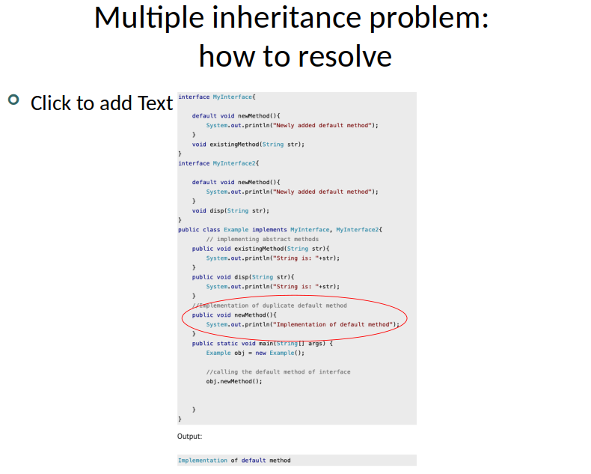
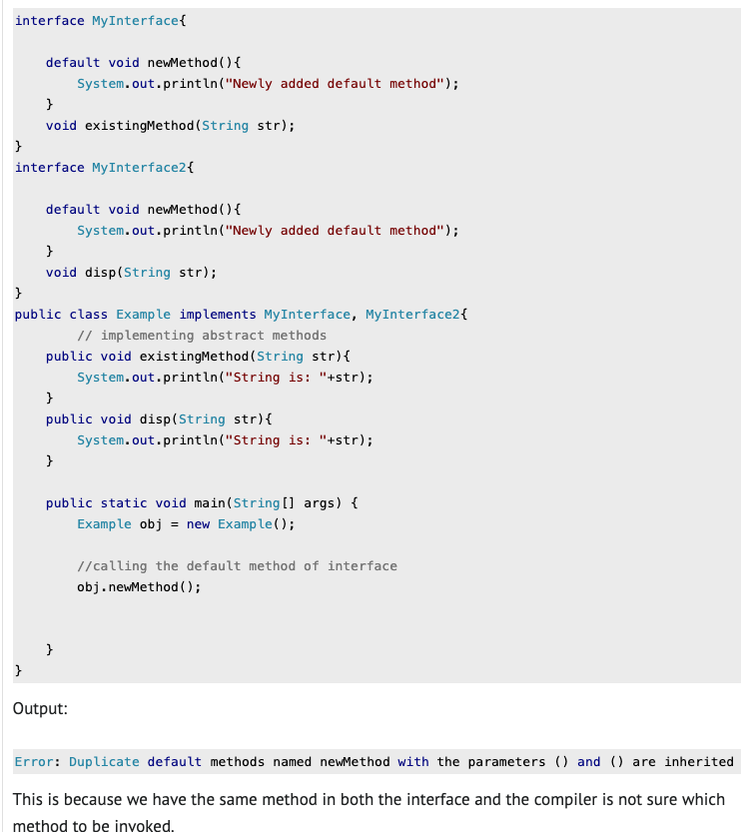

Slide 42
Static methods in interfaces
Introduced in Java 8
Similar to default methods
But since they are static, we cannot override them in the implementation classes
Having static methods in interfaces does not create a multiple inheritance problem
Why? Because we don’t have to override them in the implementation classes, as we have to do with default methods

Slide 43
Abstract Classes and Methods
A class or method is called ‘abstract’ if it is “incomplete” in some manner.
An abstract method is a method that lacks a definition.
If a class contains abstract methods, it must be labelled abstract.
But can be labelled abstract even if no abstract methods are present
An abstract class can therefore not be instantiated in itself, only extended.
The extending class must somehow make all abstract things ‘concrete’, otherwise it is also abstract (since it is still incomplete!)

Slide 44
Why Abstract Classes and Methods?
Abstract classes serve a different function than interfaces
Although in other languages, e.g. C++, abstract classes are the way to create interfaces
Think of it as a way of using a ‘template’ / injecting code that lots of classes might use, to save time / make your implementations more robust and less redundant; think of ‘extending’ an abstract class as a way of ‘dumping’ its contents (in a structured manner) into a child class, which aims to ‘fill in the gaps’.
Good for the “Don’t Repeat Yourself” (DRY) principle.

Slide 45
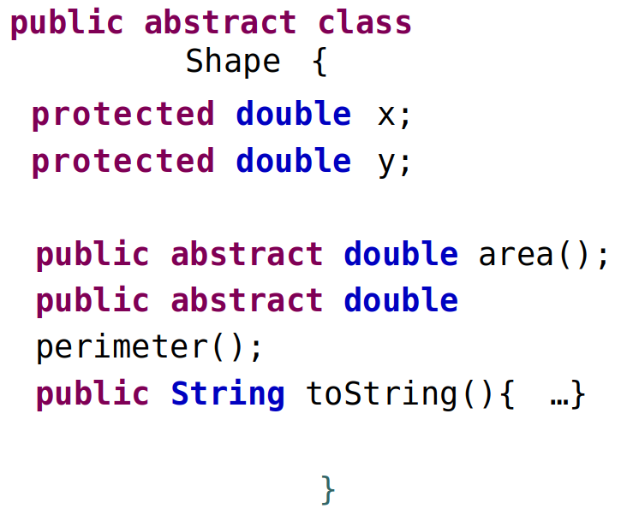

Slide 46
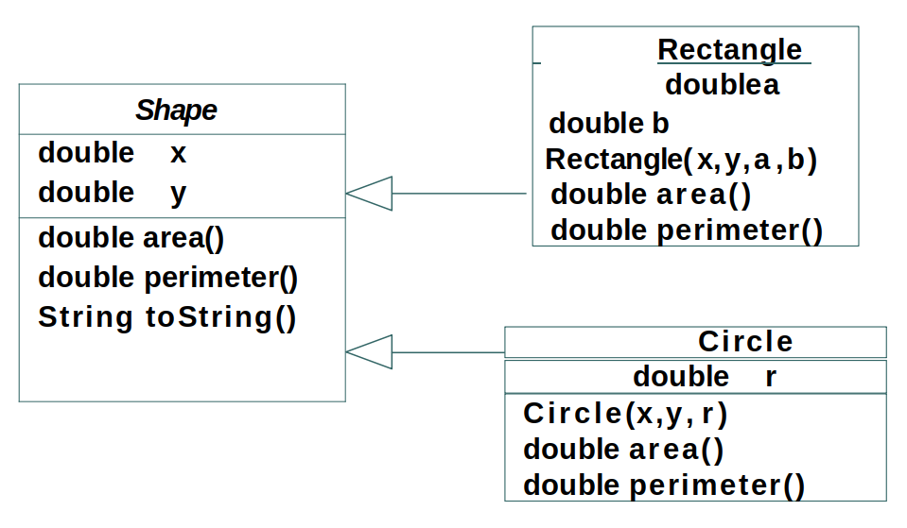

Slide 47
Object composition as an alternative to inheritance
Often, it is preferable to compose new classes from old classes by assigning objects as normal variables into the receipient class’s fields
Instead of inheriting methods, the new class delegates requests directly to the objects assigned to its fields
This is one way to “work around” the “no multiple inheritance” limitation of Java, since there is no limit to how many objects can be assigned to fields.

Slide 48
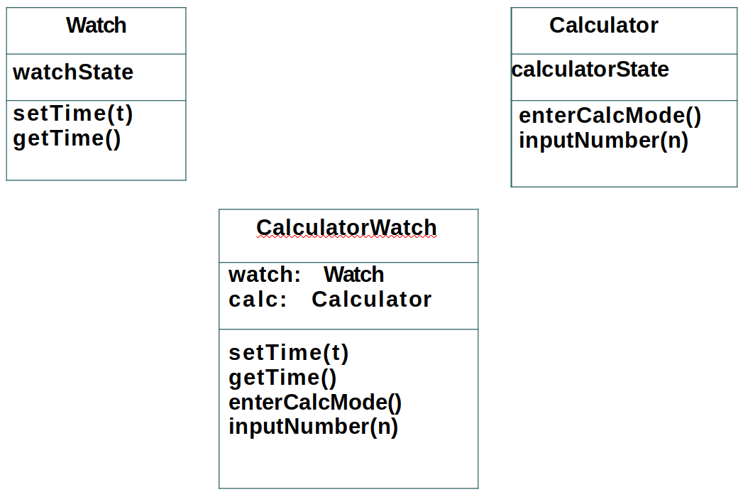

Slide 49
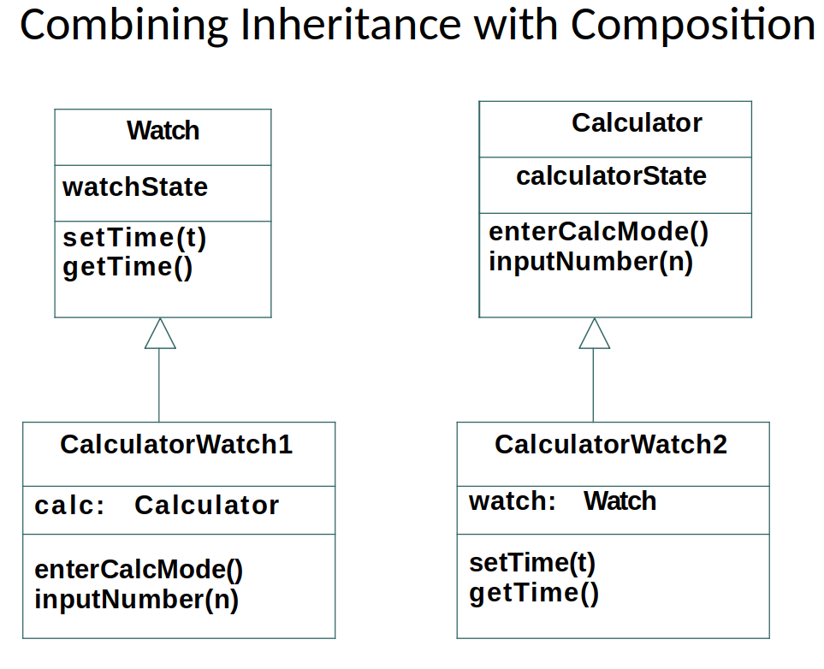

Slide 50
Polymorphism
Notes:
Any questions on Abstraction?

Slide 51
What is Polymorphism?
The word means “many forms”. In other words objects (or their methods) can take many forms
Two broad kinds:
Compile-time polymorphism (method / operator overloading)
Involves static binding (I.e. happens at compile-time)
Unlike languages like C++, matlab/octave, or python, the only overloaded operator is “+” (numbers vs Strings)
Runtime polymorphism (method overriding)
Involves dynamic binding (i.e. happens at runtime)

Slide 52
Method Overloading
Two or more methods in a class can have the same name, and represent entirely different methods!
This is possible, as long as they have different parameter signatures. E.g.:
They may have different number of input arguments
The number of arguments is the same, but the types involved in the sequence of arguments is different
Note, the return type does not participate in overloading; attempting to overload a method with the same parameter signature but different return types is not allowed
Not to be confused with method overriding, which comes into play during inheritance, and where the signature in the extending class is identical!

Slide 53
Upcasting
“Upcasting” is the act of “interpreting” a subclass as its parent type.
“Downcasting” generally not permitted (with some exceptions)
One form of (runtime) polymorphism arises from implicit upcasting when passing arguments to methods. (we have already seen something similar with interfaces)
public class Main {
public static void main (String [] args) {
Base a = new Base(); Base b = new Subclass(); Subclass c = new Subclass();
sayHello(a); sayHello(b); sayHello(c);
}
public static void sayHello (Base x) { x.hello(); }
}
class Base { public void hello () { System.out.println("Hello from Base"); } }
class Subclass extends Base { public void hello () { System.out.println("Hello from Subclass"); } }
Output:
Hello from Base
Hello from Subclass
Hello from Subclass
Notes:
Runtime because the decision which class to instantiate could come at runtime (e.g. with an if statement and external input!)
Also, note that this is not ‘hiding’.
In the second case, the ‘base’ method is unrecoverable, it simply doesn’t exist in memory!
(discuss what’s happening in terms of memory)

Slide 54
Polymorphic Arrays
A polymorphic array refers to the ability to create an array as type "Base class", but instantiate its elements using subclasses. This works due to upcasting.
class Base { public void hello() { System.out.println( "Hello from Base“ ); } }
class Subclass1 extends Base { public void hello() { System.out.println( "Hello from Subclass1“ ); } }
class Subclass2 extends Base { public void hello() { System.out.println( "Hello from Subclass2“ ); } }
public class Main {
public static void main (String [] args) {
Base [] polymorphicArray = {new Base(), new Subclass1(), new Subclass2()};
for (Base x : polymorphicArray) { x.hello(); }
}
}
Output:
Hello from Base
Hello from Subclass1
Hello from Subclass2
Notes:
Also remember what we said about covariant types earlier.

Slide 55
Packages
Not really polymorphism, but one way in which classes of the same name can be distinguished from one another. Packages effectively act as namespaces. E.g. Mine.OkClass and Yours.OkClass are different classes.
Packages in Java are created by putting your classes in a folder hierarchy
So, e.g. class com.ce303.MyClass should be file ./com/ce303/MyClass.java from your ‘launch’ directory
To compile from the root folder: javac com/ce303/MyClass.java
To run from the root folder (assuming Myclass contains a main function): java com.ce303.MyClass
Myclass.java should start with a package declaration, e.g.: package com.ce303;
Multiple ‘package-containing’ directories can be specified via the ‘classpath’ option:
e.g.: javac -classpath .:path1:path2 pkg1/Class1.java pkg2/Class2.java etc, then to run:
java -classpath .:path1:path2 pkg1.Class1 (assuming pkg1.Class1 contained a valid main function)
Notes:
Also mention modules since java 9 (and how they differ from Intellij modules)

Slide 56
Functional Interfaces
+ Lambda Expressions and Method references
Notes:
Any questions about polymorphism? (or packages?)

Slide 57
Functional Interfaces
A functional interface is any interface which only contains a Single Abstract Method.
A functional interface can contain more methods, as long as they’re not abstract (i.e. they have default implementations).
Note: Abstract methods that are direct descendants of the Object class are excluded from this definition.
Unlike other languages (e.g. python) Java doesn’t treat “functions” (i.e. class methods) as legitimate objects that can be assigned or passed to other functions (i.e. “higher order” functions).
Functional interfaces are Java’s mechanism for achieving this effect.

Slide 58
Example using a functional interface
interface MyPredicate { boolean apply( int value ); }
class SelectPositive implements MyPredicate {
public boolean apply( int value ) { return value > 0; }
}
public class Main {
public static void main( String [] args ) {
int [] list = {1, 2, -2, -4, 5};
printSelected( list, new SelectPositive() );
}
public static void printSelected( int [] array, MyPredicate predicate ) {
for (int element : array) { if (predicate.apply( element )) { System.out.print( element + “ “ ); } }
}
}

Slide 59
Functional interfaces in the Java libraries
The java.util.function package (in the java.base module) defines a variety of functional interfaces, e.g.:
Function<T,R> BiFunction<T,U,R> Predicate<T> UnaryOperator<T>
BinaryOperator<T> Consumer<T> Supplier<T>
And many specialisations for primitive types, e.g.
IntToDoubleFunction ToDoubleBiFunction DoublePredicate IntBinaryOperator LongConsumer…
Is there a more concise way of using all these functional interfaces than having to create class explicit implementations for each of these?

Slide 60
Anonymous Classes
It is possible to implement an interface (any interface, not just functional ones) “on the spot”, instead of explicitly creating a class that implements it.
Note: In fact it is possible to extend existing classes anonymously “on the spot” in the same way.
Note: anonymous classes cannot have explicit constructors
Note: an anonymous class is a normal expression, which can be part of a normal statement; the statement needs to be terminated with a semicolon like all statements. Forgetting the semicolon after the closing brace of the definition of the anonymous class is a common mistake!
See the java specification for details (https://docs.oracle.com/javase/specs/jls/se17/html/jls-15.html#jls-15.9.5)
E.g.:
MyPredicate m = new MyPredicate () { boolean apply (int x) {return x>0;} };

Slide 61
Lambda Expressions
A lambda expression is a concise syntax, which, similar to anonymous classes, it represents an “on the spot” implementation of a functional interface (specifically).
Lambda Expressions consist of:
Parameters to be supplied to the interface “function” (i.e. the target method) enclosed in parentheses
The arrow token: ->
A body, consisting of a block of statements, representing the “function’s” body.
Notes:
The parameter types can be omitted, e.g. (a, b) -> { return a + b; } instead of (int a, int b) -> { return a+b; }
If only a single argument is used, parentheses can be omitted, e.g. x -> { return x + 1;}
If the lambda doesn’t take input arguments, an empty pair of brackets is used () -> { return 5; }
If the lambda block consists of a single return statement returning an expression, the block can be replaced by the expression itself, e.g. x -> { return x + 1; } becomes x -> x + 1

Slide 62
Lambda Type Inference
As long as a lambda can be matched to an appropriate functional interface, the parameter and return value types do not have to be explicitly defined.
E.g. one can write: (a,b) -> a.toString() + b.toString()
instead of (Person a, Person b) -> a.toString() + b.toString()
as long as a) there is a valid functional interface to match against, e.g.:
public interface PersonStringAdder {
public String addPersonStrings (Person a, Person b);
}
and b) it’s the interface you’re attempting to match to in the specific context, e.g.:
PersonStringAdder mypersonstring = (a,b) -> a.toString() + b.toString()

Slide 63
Lambda Expressions: Remark
Java lambda expressions always need to be matched to a functional interface.
E.g. IntBinaryOperator f = (a, b) -> a – b;
You cannot assign a lambda expression to an Object variable:
Object obj = (a, b) -> a – b // does NOT compile

Slide 64
Method references
Very often, a lambda simply serves as a ‘redirector’, in that it’s role is simply to take some input arguments, and pass them straight into an existing method and return the result. E.g. (x) -> obj.method(x)
Java provides an concise way to express such ‘redirector lambdas’ using “method references”. There are 4 types:
Reference to a Type’s static method: (args) -> C.sm(args) ➔ C::sm
Reference to an object’s instance method: (args) -> o.im(args) ➔ o::im
Ref. to instance method of object of a certain type, passed as the first parameter to the lambda: (C o, args) -> o.im(args) ➔ C::im
Reference to a constructor: (args) -> new C(args) ➔ C::new
(Legend: sm denotes a static method, im denotes an instance method, o an instance object, C a classname)

Slide 65
Academic hours: Wednesdays 09:00-11:00 (please email if you can)
Notes:
Encourage you to ask questions on moodleoverflow and encourage other students to answer.
I will periodically look at moodle to answer questions.
If people have questions by email, I will redirect them to moodle if I think they are useful to the class.
Happy to see people during my academic hours, but please email me first if you can, since my office is outside campus and requires a keycard!
Now we’re going to the labs in the CSEE building!

